Slide 1
The History of the Health Message in the SDA Church
Healthy, Holy, Happy

Slide 2
Introduction
This presentation looks, briefly at that too, at the history of the health message within Seventh-day Adventism.
At the end of this presentation participants should be able to:
Identify the attending circumstances within which the SDA health message was developed.
Be familiar with the names of some of the major players at the onset of the SDA health message.
Have a deeper appreciation for the role of Ellen G. White in guiding the development of the SDA health message
Have greater confidence in our health message
Share with others the rich history of the SDA health message

Slide 3
Background to SDA Health Ministry Development
The “good old days were terrible!”
Common health practices were, well, unhealthy.
A number of medications were poison.
Hospitals were places where you go to die.
Poor hygiene
Lack of understanding of the causes of diseases
High infant mortality and low life expectancy.

Slide 4
Moves to Change
One of the strong impulses in mid-19th century America was reform.
Health was one of the areas where reform was needed and there were moves in that direction.

Slide 5
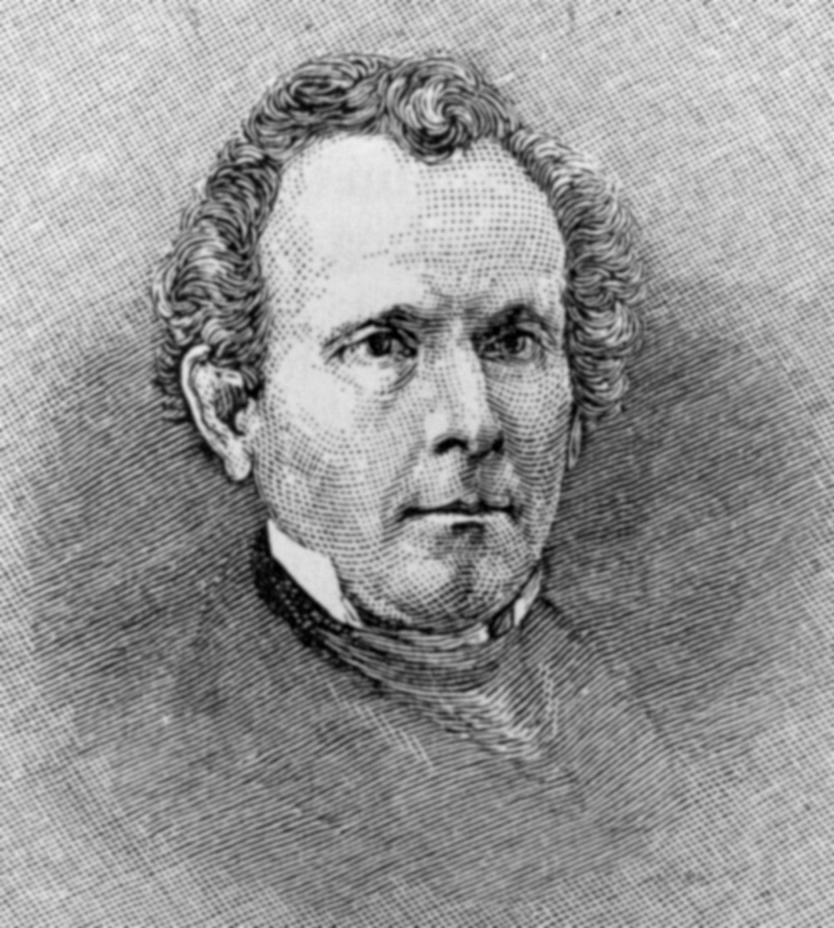
Moves to Change
Sylvester Graham
He was an advocate for dietary reform.
He promoted the use of whole grain products.
Promoted vegetarianism.
A strong supporter of the temperance movement.
Invented Graham flour, Graham bread and Graham crackers.

Slide 6
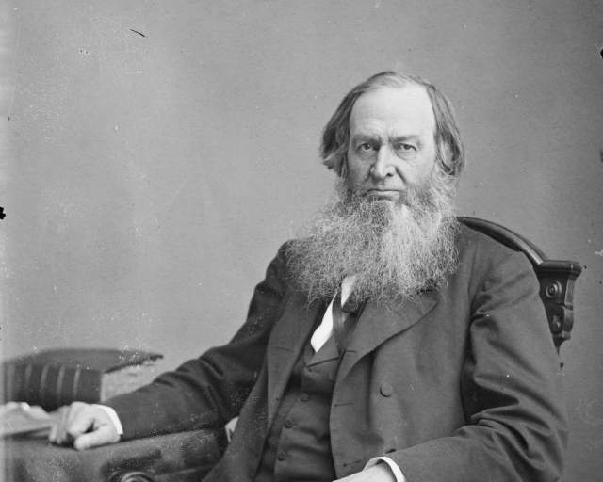
Moves to Change
James C. Jackson
Promoted dress reform—which was mainly targeting reform in women’s clothing.
Invented granula—yes, you heard it right.
Operated a hydropathic cure, Our Home on the Hillside, in Dansville, NY.
In the early 1860s several prominent SDA leaders received treatment there.

Slide 7
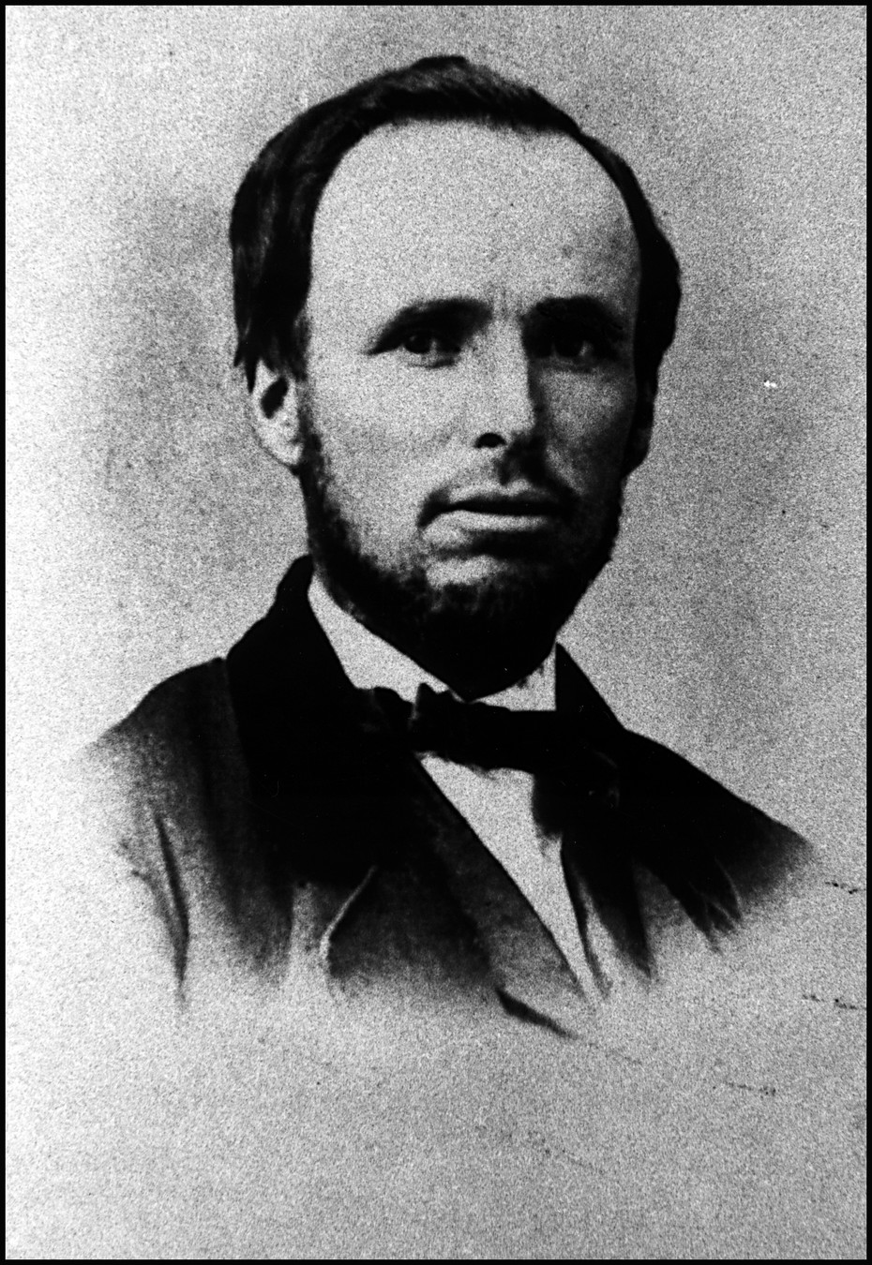
Moves to Change
He was the first head of the Western Health Reform Institute—more on this later.
Served as the editor of the Health Reformer from 1866-1868.
Lay spent time, before 1866, as a staff member of Our Home on the Hillside.
In later life he held ministerial credentials.

Slide 8

Excitement!
June 6, 1863 Ellen White received her first comprehensive health reform vision.
“I saw that now we should take special care of the health God has given us, for our work was not yet done. Our testimony must yet be borne and would have influence.”
Health reform was needed within Adventism.

Slide 9
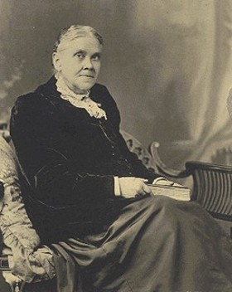
Excitement!
“I saw that it was a sacred duty to attend to our health, and arouse others to their duty. ... We have a duty to speak, to come out against intemperance of every kind—intemperance in working, in eating, in drinking, in drugging—and then point them to God’s great medicine: water, pure soft water, for diseases, for health, for cleanliness, for luxury. ... I saw that we should not be silent upon the subject of health, but should wake up minds to the subject.”—E. G. White Letter 4, 1863.

Slide 10
Health, Or How To Live
Health, or How to Live was a series of six pamphlets produced by Adventism, in 1865, as a means of promoting its health message.
Each issue contained a missive from Sis White as well as articles/extracts from notable health reformers such as Russell Trall, Sylvester Graham, James C. Jackson, and others.

Slide 11
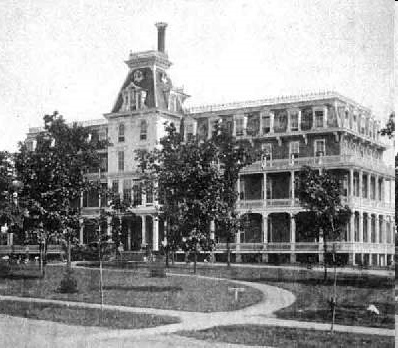
More Excitement! Arise and Build
“Christmas evening, as we were humbling ourselves before God, and earnestly pleading for deliverance, the light of Heaven seemed to shine upon us, and I was wrapt in a vision of God’s glory. It seemed that I was borne quickly from earth to heaven, where all was health, beauty, and glory.”—The Review and Herald, February 27, 1866.

Slide 12
More Excitement! Arise and Build
“I was shown that we should provide a home for the afflicted and those who wish to learn how to take care of their bodies that they may prevent sickness. ... SHM 142.1
“Sabbathkeepers should open a way for those of like precious faith to be benefited without their being under the necessity of expending their means at institutions where their faith and religious principles are endangered, and where they can find no sympathy or union in religious matters. ... SHM 142.2
“Our people should have an institution of their own, under their own control, for the benefit of the diseased and suffering among us, who wish to have health and strength that they may glorify God in their bodies and spirits which are His.”— SHM 142.3.
Thus in 1866 the Western Health Reform Institute was established in Battle Creek, MI.

Slide 13
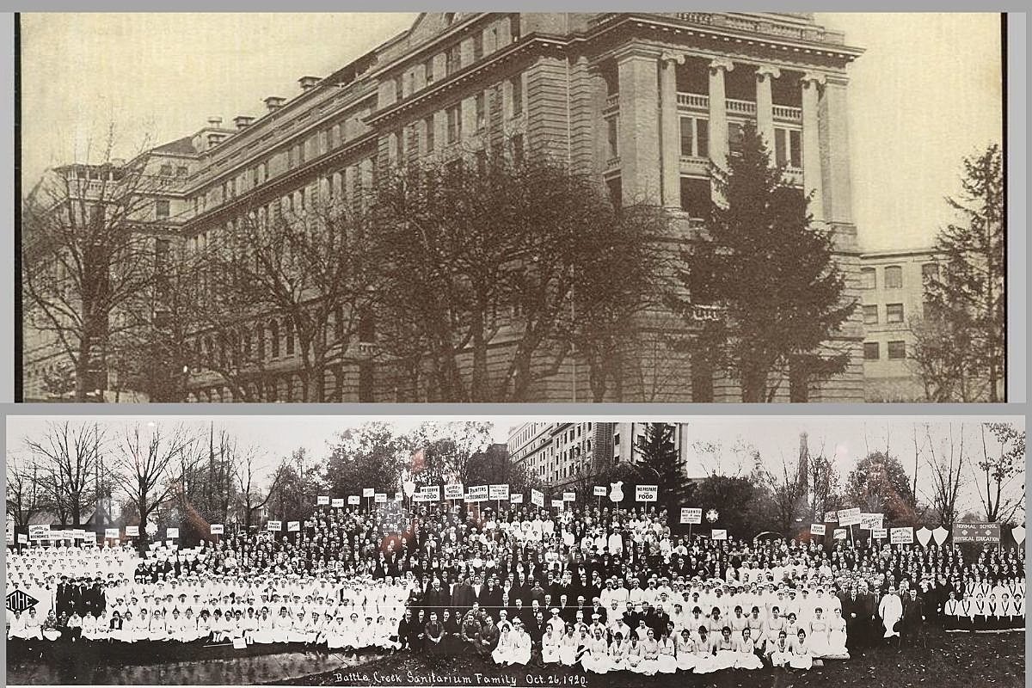
Things are Getting Better
  In 1876 the name was changed to the Battle Creek Sanitarium and John Harvey Kellogg was the Chief of Staff.
  It soon became one of the most prominent health reform institutions in the US.

Slide 14

Things are Getting Better
Some notable patients at the Sanitarium:
Warren G. Harding, 29th President of the US
Amelia Earhart
Henry Ford
James Cash Penny
Sojourner Truth
Mary Todd Lincoln

Slide 15
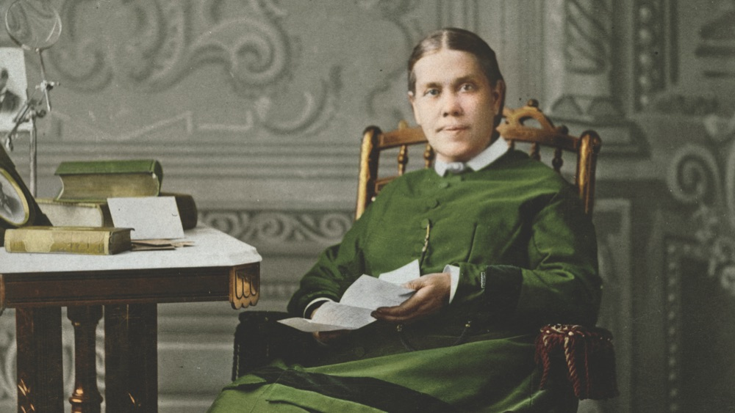
Good Healthy Reading
An Appeal to Mothers (1864)
“Health,” Spiritual Gifts, volume 4a (1864)
“Disease and Its Causes” in the booklet Health, or How to Live (1865)
Christian Temperance and Bible Hygiene (1890)
The Ministry of Healing (1905)

Slide 16
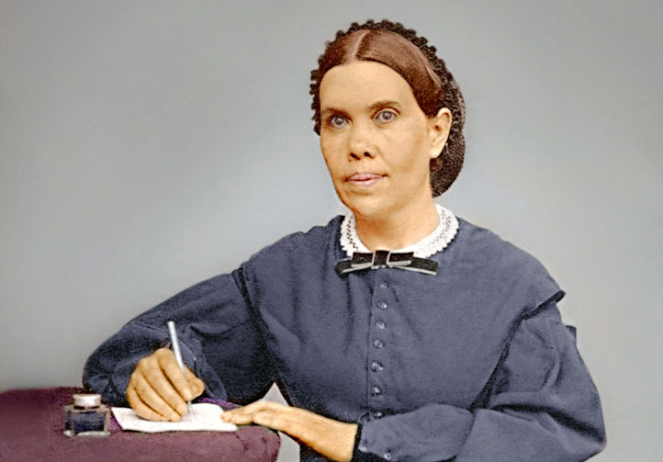
Good Healthy Reading
Healthful Living (1897)
Counsels on Health (1923)
Medical Ministry (1932)
Counsels on Diet and Foods (1938)
Temperance (1949)

Slide 17
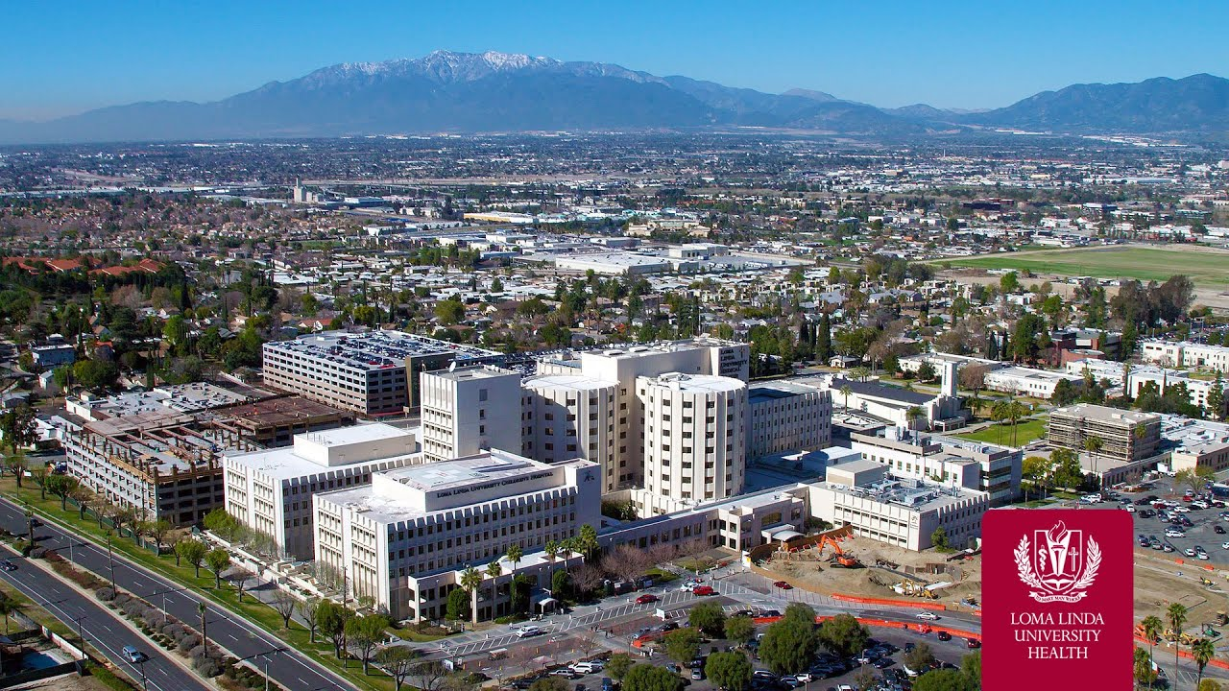
Institutions
Hospitals and Sanitariums | 229
Nursing Homes and Retirement Centers | 129
Clinics and Dispensaries | 1,475
Dental Clinics | 128
Orphanages and Children’s Homes | 15
Inpatient Visits | over 1 million
Outpatient Visits | over 21 million

Slide 18
Some Benefits
Better quality of life
Happier life—there is a close relationship between health and happiness.
A strong means of Christian witness—health is everybody’s concern.
Longer life—on average Adventists tend to live longer than the general population.

Slide 19
Conclusion
Health ministry within Seventh-day Adventism is very integral and beneficial
We weren’t always health conscious, however, God used Sis White to help, in a tremendous manner, to bring health to the forefront of Adventism.
Today the church operates a rather robust health network and its overall health message is a blessing to millions.

